Slide 1
Chapter 2: Working with Hibernate

Slide 2
Learning Objectives
Hibernate Data Types.
Exploring Hibernate API
Configuration xml file and Mapping xml file along with dtds.
Introduction to JPA Annotations
Persistent Classes (POJO)

Slide 3
Hibernate Types Mapping
When you prepare a Hibernate mapping document, we have seen that you map Java data types into RDBMS data types. The types declared and used in the mapping files are not Java data types; they are not SQL database types either. These types are called Hibernate mapping types, which can translate from Java to SQL data types and vice versa.

Slide 4
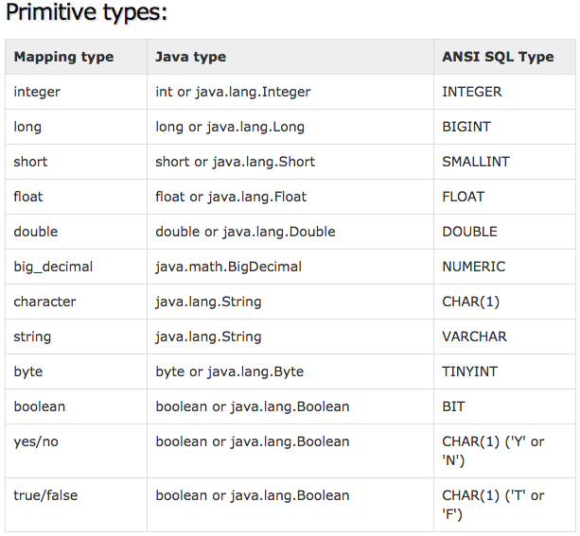
Hibernate Types Mapping: Primitives

Slide 5
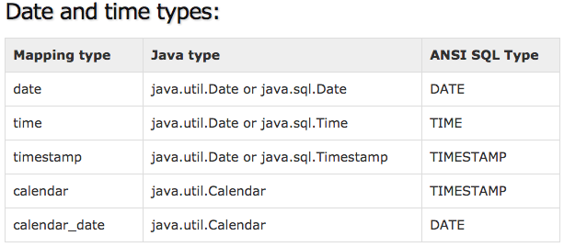
Hibernate Types Mapping: Primitives

Slide 6
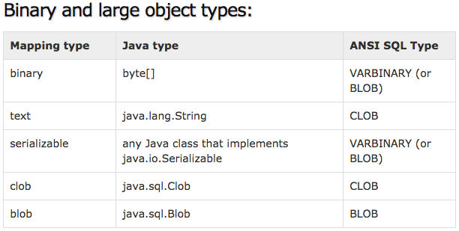
Hibernate Types Mapping: Primitives

Slide 7
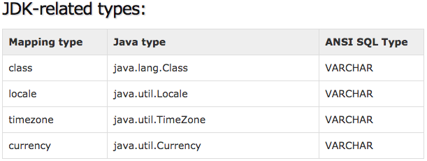
Hibernate Types Mapping: Primitives

Slide 8
Association Mappings
Association mappings are one of the key features of Hibernate. They model the relationship between two database tables as attributes in your domain model.
Hibernate supports the same associations as you know from your relational database model. You can use:
one-to-one associations,
many-to-one associations and
many-to-many associations.

Slide 9
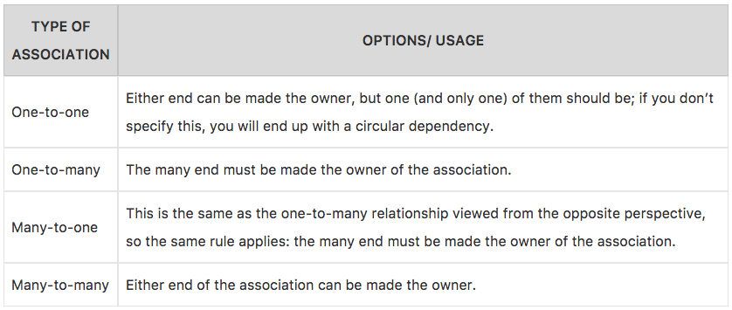
Association Mappings

Slide 10
Exploring Hibernate API
Hibernate, as an ORM solution, effectively "sits between" the Java application data access layer and the Relational Database, as can be seen in the diagram above.
The Java application makes use of the Hibernate APIs to load, store, query, etc. its domain data.
Here we will introduce the essential Hibernate APIs.
This will be a brief introduction; we will discuss these contracts in detail later.
As a JPA provider, Hibernate implements the Java Persistence API

Slide 11
Exploring Hibernate API

Slide 12
Hibernate API
SessionFactory (org.hibernate.SessionFactory): A thread-safe (and immutable) representation of the mapping of the application domain model to a database. Acts as a factory for org.hibernate.Session instances. The EntityManagerFactory is the JPA equivalent of a SessionFactory and basically those two converge into the same SessionFactory implementation.A SessionFactory is very expensive to create, so, for any given database, the application should have only one associated SessionFactory. The SessionFactory maintains services that Hibernate uses across all Session(s) such as second level caches, connection pools, transaction system integrations, etc.
Session (org.hibernate.Session): A single-threaded, short-lived object conceptually modeling a "Unit of Work" PoEAA. In JPA nomenclature, the Session is represented by an EntityManager. Behind the scenes, the Hibernate Session wraps a JDBC java.sql.Connection and acts as a factory for org.hibernate.Transaction instances. It maintains a generally "repeatable read" persistence context (first level cache) of the application domain model.
Transaction (org.hibernate.Transaction): A single-threaded, short-lived object used by the application to demarcate individual physical transaction boundaries. EntityTransaction is the JPA equivalent and both act as an abstraction API to isolate the application from the underlying transaction system in use (JDBC or JTA).

Slide 13
Basic O/R Mapping
Object/relational mappings are usually defined in an XML document. The mapping document is designed to be readable and hand-editable. The mapping language is Java-centric, meaning that mappings are constructed around persistent class declarations and not table declarations.
All XML mappings should declare the doctype shown. The actual DTD can be found at the URL above, in the directory hibernate-x.x.x/src/org/hibernate , or in hibernate3.jar. Hibernate will always look for the DTD in its classpath first. If you experience lookups of the DTD using an Internet connection, check the DTD declaration against the contents of your classpath.
Hibernate will first attempt to resolve DTDs in its classpath. It does this is by registering a custom org.xml.sax.EntityResolver implementation with the SAXReader it uses to read in the xml files. This custom EntityResolver recognizes two different systemId namespaces:
a hibernate namespace is recognized whenever the resolver encounters a systemId starting with http://hibernate.sourceforge.net/. The resolver attempts to resolve these entities via the classloader which loaded the Hibernate classes.
a user namespace is recognized whenever the resolver encounters a systemId using a classpath:// URL protocol. The resolver will attempt to resolve these entities via (1) the current thread context classloader and (2) the classloader which loaded the Hibernate classes.

Slide 14
Hibernate-mapping
The schema and catalog attributes specify that tables referred to in this mapping belong to the named schema and/or catalog.
If they are specified, tablenames will be qualified by the given schema and catalog names. If they are missing, tablenames will be unqualified.
The default-cascade attribute specifies what cascade style should be assumed for properties and collections that do not specify a cascade attribute.
By default, the auto-import attribute allows you to use unqualified class names in the query language.
If you have two persistent classes with the same unqualified name, you should set auto-import="false". An exception will result if you attempt to assign two classes to the same "imported" name.
The hibernate-mapping element allows you to nest several persistent <class> mappings, as shown above.
It is, however, good practice (and expected by some tools) to map only a single persistent class, or a single class hierarchy, in one mapping file and name it after the persistent superclass.
For example, Cat.hbm.xml, Dog.hbm.xml, or if using inheritance, Animal.hbm.xml.

Slide 15
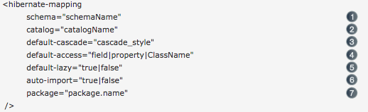
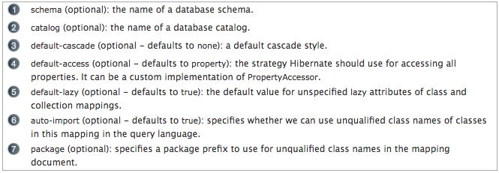
Hibernate-mapping

Slide 16
Class
You can declare a persistent class using the class element.
It is acceptable for the named persistent class to be an interface. You can declare implementing classes of that interface using the <subclass> element. You can persist any static inner class. Specify the class name using the standard form i.e. e.g.Foo$Bar.
Immutable classes, mutable="false", cannot be updated or deleted by the application. This allows Hibernate to make some minor performance optimizations.
The optional proxy attribute enables lazy initialization of persistent instances of the class. Hibernate will initially return CGLIB proxies that implement the named interface. The persistent object will load when a method of the proxy is invoked.
Implicit polymorphism means that instances of the class will be returned by a query that names any superclass or implemented interface or class, and that instances of any subclass of the class will be returned by a query that names the class itself.
Explicit polymorphism means that class instances will be returned only by queries that explicitly name that class. Queries that name the class will return only instances of subclasses mapped inside this <class> declaration as a <subclass> or <joined-subclass>.

Slide 17
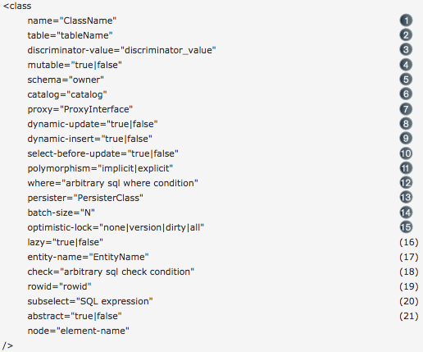
Class

Slide 18
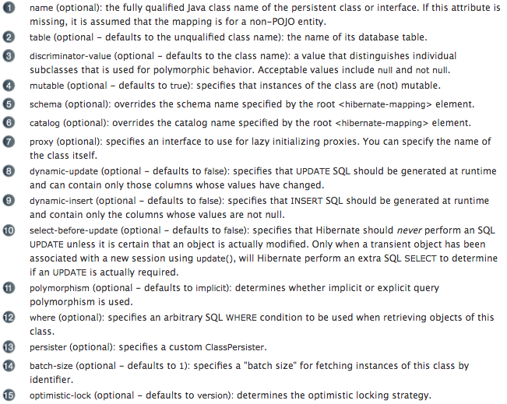
Class

Slide 19
ID
Mapped classes must declare the primary key column of the database table. Most classes will also have a JavaBeans-style property holding the unique identifier of an instance.
The <id> element defines the mapping from that property to the primary key column.
If the name attribute is missing, it is assumed that the class has no identifier property.
The unsaved-value attribute is almost never needed in Hibernate3.
There is an alternative <composite-id> declaration that allows access to legacy data with composite keys. Its use is strongly discouraged for anything else.

Slide 20
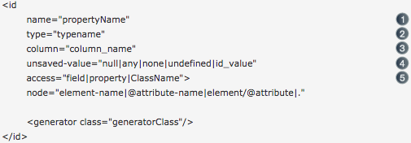
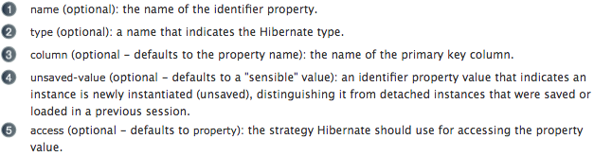
ID

Slide 21
JPA Annotations
JPA entities are plain POJOs. Actually, they are Hibernate persistent entities. Their mappings are defined through JDK 5.0 annotations instead of hbm.xml files.
A JPA 2 XML descriptor syntax for overriding is defined as well). Annotations can be split in two categories, the logical mapping annotations (describing the object model, the association between two entities etc.) and the physical mapping annotations (describing the physical schema, tables, columns, indexes, etc).
Your favorite IDE can auto-complete annotations and their attributes for you (even without a specific "JPA" module, since JPA annotations are plain JDK 5 annotations).
Following are the advantages of using JPA:
Idiomatic persistence : It enables you to write the persistence classes using object oriented classes.
High Performance : It has many fetching techniques and hopeful locking techniques.
Reliable : It is highly stable and eminent. Used by many industrial programmers.

Slide 22
JPA Annotations

Slide 23
JPA Annotations: Process
Phase1: The first phase, named as the Object data phase contains POJO classes, service interfaces and classes. It is the main business component layer, which has business logic operations and attributes.
Phase 2: The second phase named as mapping or persistence phase which contains JPA provider, mapping file (ORM.xml), JPA Loader, and Object Grid.
JPA Provider : The vendor product which contains JPA flavor (javax.persistence). For example Eclipselink, Toplink, Hibernate, etc.
Mapping file : The mapping file (ORM.xml) contains mapping configuration between the data in a POJO class and data in a relational database.
JPA Loader : The JPA loader works like cache memory, which can load the relational grid data. It works like a copy of database to interact with service classes for POJO data (Attributes of POJO class).
Object Grid : The Object grid is a temporary location which can store the copy of relational data, i.e. like a cache memory. All queries against the database is first effected on the data in the object grid. Only after it is committed, it effects the main database.

Slide 24
JPA Annotations: Process
Phase 3: The third phase is the Relational data phase. It contains the relational data which is logically connected to the business component. As discussed previously, only when the business component commit the data, it is stored into the database physically.
Until then the modified data is stored in a cache memory as a grid format. Same is the process for obtaining data.
The mechanism of the programmatic interaction of all three phases is called as object relational mapping.
The mapping.xml file is to instruct the JPA vendor for mapping the Entity classes with database tables.
Here is the solution: In the class definition, we can write the configuration part using annotations. The annotations are used for classes, properties, and methods.
Annotations starts with ‘@’ symbol. Annotations are declared before the class, property or method is declared.
All annotations of JPA are defined in javax.persistence package.

Slide 25
JPA Annotations
Annotation | Description
@Entity | This annotation specifies to declare the class as entity or a table.
@Table | This annotation specifies to declare table name.
@Basic | This annotation specifies non constraint fields explicitly.
@Embedded | This annotation specifies the properties of class or an entity whose value instance of an embeddable class.
@Id | This annotation specifies the property, use for identity (primary key of a table) of the class.
@GeneratedValue | This annotation specifies, how the identity attribute can be initialized such as Automatic, manual, or value taken from sequence table.
@Transient | This annotation specifies the property which in not persistent i.e. the value is never stored into database.

Slide 26
JPA Annotations
Annotation | Description
@Column | This annotation is used to specify column or attribute for persistence property.
@SequenceGenerator | This annotation is used to define the value for the property which is specified in @GeneratedValue annotation. It creates a sequence.
@TableGenerator | This annotation is used to specify the value generator for property specified in @GeneratedValue annotation. It creates a table for value generation.
@AccessType | This type of annotation is used to set the access type. If you set @AccessType(FIELD) then Field wise access will occur. If you set @AccessType(PROPERTY) then Property wise assess will occur.
@JoinColumn | This annotation is used to specify an entity association or entity collection. This is used in many- to-one and one-to-many associations.
@UniqueConstraint | This annotation is used to specify the field, unique constraint for primary or secondary table.

Slide 27
JPA Annotations
Annotation | Description
@ColumnResult | This annotation references the name of a column in the SQL query using select clause.
@ManyToMany | This annotation is used to define a many-to-many relationship between the join Tables.
@ManyToOne | This annotation is used to define a many-to-one relationship between the join Tables.
@OneToMany | This annotation is used to define a one-to-many relationship between the join Tables.
@OneToOne | This annotation is used to define a one-to-one relationship between the join Tables.
@NamedQueries | This annotation is used for specifying list of named queries.
@NamedQuery | This annotation is used for specifying a Query using static name.

Slide 28
JPA Annotations: POJO
POJO stands for Plain Old Java Object, which are nothing but the classes that follow the Java Bean standards.
We have already seen the Java Bean conventions. A Java class, encapsulates the instance values and behaviors into a single unit called object. Java Bean is a temporary storage and reusable component or an object. It is a serializable class which has default constructor and getter & setter methods to initialize the instance attributes individually.
We use JPA annotations on POJO (Java Beans) classes (instead of mapping files) to make them persistence friendly using an ORM.

Slide 29
What are we learning in Next Chapter ?
You will learn about CRUD using Hibernate
We will learn about:
CRUD/DML operations (Create, Retrieve, Update and Delete)
Configuring Primary key Generators
Hibernate Query Language (HQL)
Native SQL
Criteria API

Slide 30
Thank You !

